Slide 1
Java Server Pages
JSP – Server Side Scripting

Slide 2
Responsibilities of Servlets
Coding the presentation logic and business logic together is not a good practice
  A change in any one of these requires the modification of the entire code
  Programmers with different skill sets are required for creating and maintaining these
Servlets, being Java programs, are best suited for coding business logic
Notes:
Programming and web designing are altogether two different skills. It is not usual for a person to have both these skills. For writing a Servlet, one requires both programming and web designing skills.

Slide 3
Responsibilities of Servlets
Servlets are not suitable to code presentation logic
  It is not easy to mix static contents with dynamic contents in Servlets
  As Servlets are not as easy as HTML, it will be difficult for web designers to use this technology
A technology with the power of Servlets and ease of HTML is required to code presentation logic, so that web designers can also easily use it.
Notes:
Most dynamic pages may have a static content in it. For example, the header part (name of the company, logo etc) and footer part (next, previous, print this page and email this page buttons) may remain the same always where as only the central part is really dynamic. Mixing such static content with dynamic content is difficult in Servlets

Slide 4
Java Server Pages - Background
JSPs were invented to take care of the View.
JSPs allow you to mix static (non-changing) HTML with snippets of Java code.
You first generate the HTML page (giving it the .htm extension) and then, when you have decided what parts should have dynamic content, you add in the Java portions and rename the file .jsp

Slide 5
Java Server Pages - Background
Converting a web page from .htm to .jsp is as simple as renaming the file.
In the web application server, you can place a .jsp file anywhere you place an .htm file.
You do not even need to compile a .jsp!
No bothering with packages
No bothering with CLASSPATHs.
In fact, to use a JSP, all you need is a web server that is a web application server—meaning one that is configured to handle JSPs

Slide 6
Behind the scenes

Slide 7
JavaServer Pages: Behind the Scenes
Outside of your view, the web application server is compiling your JSP.
When a JSP is compiled, it is turned into a Servlet.
In other words, a JSP is a Servlet in disguise.

Slide 8
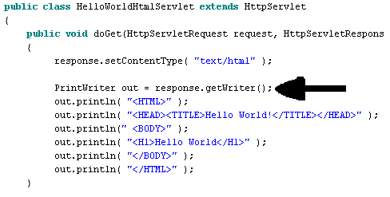
JavaServer Pages: Behind the Scenes
• Recall in the case of Servlets, we were just writing HTML code to the output stream.

Slide 9
JavaServer Pages: Behind the Scenes
In the case of a JSP, the exact same thing is happening, but instead of you having the tedious chore of writing all that HTML, it is automated.
So, when we get ready to execute our JSPs, we should go and look for these generated files so we understand what is happening behind the scenes.

Slide 10
JavaServer Pages: Behind the Scenes
It is important to do so in case you have an error in your JSP. The JSP you wrote is two steps away from its final destination.
Because of this two-step translation process, it can be hard to debug these unless you understand what is happening.

Slide 11
Benefits of JSP
Although JSP technically can’t do anything servlets can’t do, JSP makes it easier to:
  Write HTML
  Read or maintain the HTML
JSP makes it possible to:
  Use standard HTML tools such as Macromedia DreamWeaver.
  Have different members of your team do the HTML layout than do the Java programming
JSP encourages you to
  Separate the (Java) code that creates the content from the (HTML) code that presents it.

Slide 12
Our First JSP

Slide 13
Java Server Pages – Our First JSP
To start, let’s define a JSP that does exactly nothing.
We’ll start off with the simplest HTML page, and do nothing but change its name to .jsp.
  Then, let’s see what happens to it.

Slide 14
• This page is called BasicHtml.htm
<HTML>
<HEAD>
<TITLE>This is raw html</TITLE>
</HEAD>
<BODY>
This is the part that displays in the page.
</BODY>
</HTML>

Slide 15
• This page is called BasicJSP.jsp
<HTML>
<HEAD>
<TITLE>This is raw html</TITLE>
</HEAD>
<BODY>
This is the part that displays in the page.
</BODY>
</HTML>

Slide 16
Java Server Pages
Unlike HTML files, JSP files will contain some Java code also with in <% %> tags
When a client requests for a JSP, the Server (For example, Tomcat), sends the HTML tags as such to the browser
The code between <% and %> will be compiled, executed and the output will be send to the browser

Slide 17
Adding Java Code to JSP

Slide 18
Adding Java Code
The whole point of using a JSP is that it allows you to insert bits of Java code into your JSP.
There are three different kinds of Java code you can add to a JSP:
  Comments
  Declarations
  Scriptlets
  Expressions

Slide 19
Comments
<!-- This is a comment in HTML -->
A JSP specific comment tag is written as follows
<%-- This is a JSP Comment --%>

Slide 20
Scripting Elements - Declaration of variables
Variables declared within <% and %> will be local to the service method of the generated Servlet and each request will have a separate copy of this variable
Variables declared within <%! and %> will be a data member of the generated Servlet class and all the requests will use the same copy of this variable
<% int data; %>
<%! double amount; %>

Slide 21
Scripting Elements - Declaration of methods
Methods also can be declared using scripting elements
All methods should be declared within <%! and %> and they become a method of the generated Servlet

Slide 22
Scriptlets
To add a scriptlet to your JSP, you put it in this form:
<% Code goes here; %>
A Scriptlet must be a complete Java statement, meaning it ends in a semicolon. You can declare a variable here, but it will be a local variable, not an instance variable.
<% String x; %>
or
<% x = x + “ from JSPLand”; %>

Slide 23
Expressions
These are evaluated and inserted into the output of the Servlet. These are commonly used to insert dynamic content into a parameter of an HTML tag.
To add an expression to your JSP, you put it in this form:
<%=Code goes here %>
Notice that an expression is not a complete Java statement and so it does not end in a semicolon.
<%=x %>
No Semicolon!

Slide 24
Implicit Objects
A JSP developer can use some implicit objects.
Some of the important objects and their classes are as follows
  out (JSPWriter)
  request (HttpServletRequest)
  response (HttpServletResponse)
  session (HttpSession)
  config (ServletConfig)
  exception (Throwable)
These objects will be declared by the generated Servlet and hence the statements we write in JSP using these variables will get a meaning once they are pasted in the Servlet code

Slide 25
Scripting Elements - Declaration of JSP Lifecycle methods
The code that should be executed only once when the JSP is invoked for the first time can be coded in a method jspInit()
The code that should be executed only once when the JSP is unloaded from the memory can be coded in a method jspDestroy()
Typically this method contains code to cleanup the resources used by the JSP

Slide 26
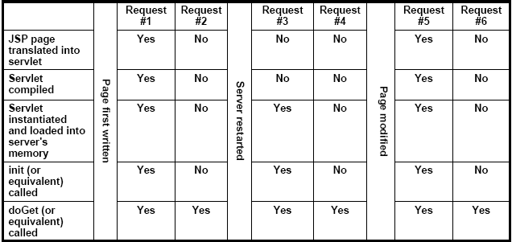
The JSP LifeCycle

Slide 27
Standard Action Elements

Slide 28
Standard Action Elements
Actions are executed when a client requests a JSP page.
They also use the same XML syntax that we will see being used more and more.
They do things such as:
  Input Validation
  Database Access
  Passing Control to Another Page.

Slide 29
Standard Action Elements
An Action Element consists of a Start Tag, a Body and an End Tag.
<jsp:forward page=“nextPage.jsp”>
<jsp:param name=“aParam” value=“aValue” />
</jsp:forward>
If the Action Element does not have a body, you can use a shorthand notation:
<jsp:forward page=“nextPage.jsp” />
The <jsp:forward> action passes the request processing control to another JSP or Servlet in the same web application. Execution of the current page is terminated at that point.
The <jsp:param> action in the body of a <jsp:forward> is used to specify additional request parameters for the target resource.

Slide 30
JavaServer Pages:
Directives

Slide 31
JavaServer Pages: Directives
A JSP Directive affects the overall structure of the Servlet that results from the JSP page.
Let’s recall the previous kinds:
<%! %> — declaration
<% %> — scriptlet
<%= %> — expression
A directive takes this form:
<%@ %> — directive

Slide 32
JavaServer Pages: Directives
There are three commonly used directives:
  page
  include
  taglib

Slide 33
JavaServer Pages: Directives
There are three commonly used directives:
  page—this lets you import classes, customize the servlet’s superclass, set the content type, etc.
This directive can be used anywhere in the page but normally it is placed first.

Slide 34
JavaServer Pages: Directives
There are three commonly used directives:
  include : this lets you insert a file into the servlet class at the time the JSP is converted into a servlet.
This directive is placed in the JSP file at the place where you want the file to be inserted.

Slide 35
JavaServer Pages: Directives
There are three commonly used directives:
  taglib : this is used to define custom markup tags.

Slide 36
JavaServer Pages:
Directives—page
Neelam Agarwal

Slide 37
Page Directive
When you have declared a page directive, there are several attributes you can use:
  import
  contentType
  isThreadSafe
  session
  buffer
  autoflush
  extends
  info
  errorPage
  isErrorPage
  language

Slide 38
Page Directive
import—specify which packages to import when your JSP is converted into a Servlet.
<%@ page import=“java.util.*” %>
Or
<%@ page import=“my.package.*, my.other.package.*“ %>
This is the only directive that can appear multiple times within your JSP.
By custom, this appears first in your JSP.

Slide 39
Page Directive
contentType—this sets the content type response header, telling the MIME type of the document being sent to the client.
<%@ page contentType=“text/plain” %>
For a JSP, the default MIME type is text/plain.
The above statement works just like this:
<% response.setContentType( “text/plain” ); %>

Slide 40
Page Directive
isThreadSafe—This controls whether or not the servlet that results from the JSP page will implement the SingleThreadModel interface.
<%@ page isThreadSafe=“false” %>

Slide 41
Page Directive
session—This controls whether or not the page participates in HTTP sessions. The default on this is true.
  This is very commonly used.
<%@ page session=“true” %>
When this is true, it means that predefined variable session should be bound to the existing session if one exists. If one does not exist, one should be created and bound to the reference session.

Slide 42
Page Directive
buffer—This specifies the size of the buffer used by the out variable. This is used if your page is large and you want to make sure the entire page is rendered in memory before the user sees it.
<%@ page buffer=“29kb” %>

Slide 43
Page Directive
autoflush—This controls whether the output buffer should be automatically flushed when it is full or whether it should be allowed to overflow (and throw an exception when it does.)
<%@ page autoflush=“true” %> (the default)
Normally, it’s a good idea not to tamper with this unless you have a good reason.

Slide 44
Page Directive
extends—This specifies the Superclass of the servlet that will be generated for the JSP.
<%@ page extends=“my.package.MySuperclass” %>
This is rarely used.

Slide 45
Page Directive
info—This defines a string that can be retrieved from the servlet by means of the method getServletInfo().
<%@ page info=“Hello, I’ll be your servlet today” %>

Slide 46
Page Directive
errorPage—This identifies which JSP page should be used if an error occurs. That means if an exception was thrown on the page (and not caught), the user will be sent to this page.
<%@ page errorPage=“/errorJSP.jsp” %>
This uses a relative URL.

Slide 47
Page Directive
isErrorPage—This works in concert with the previous attribute. This means the current JSP can act as an Error Page.
<%@ page isErrorPage=“true” %>
The default is false.
Error pages like Error.jsp in the previous example should contain this tag
The presence of this tag creates a new Throwable object called exception in the generated Servlet
The exception generated in the original page and passed as an attribute of the request will be assigned to this
So, exception is an implicit object that we can use only in error pages

Slide 48
Page Directive
language—This is a little-used attribute. Originally, the creators of JavaServer Pages hoped that JSPs would be used for multiple languages.
<%@ page language=“Java” %>
However, the only legal choice is Java—which is the default anyway.

Slide 49
JavaServer Pages:
Directives—include

Slide 50
Include Directive
This useful directive lets you include other JSPs in your JSP. That might consists of a footer, a header or other things you want.
The files are included in the JSP before it is converted into a servlet so you can include executable content.
<%@ include file=“/my.jsp” %>
Remember, the leading slash means “relative” URL.

Slide 51
Include Directive
Remember, this syntax means the JSP file in included in the main JSP document at the time when the JSP is translated into a servlet
<%@ include file=“/my.jsp” %>
By contrast, there is another syntax:
<jsp:include page=“/my.html” flush=“true” />
Include happens at page translation time.
Include happens at page request time.

Slide 52
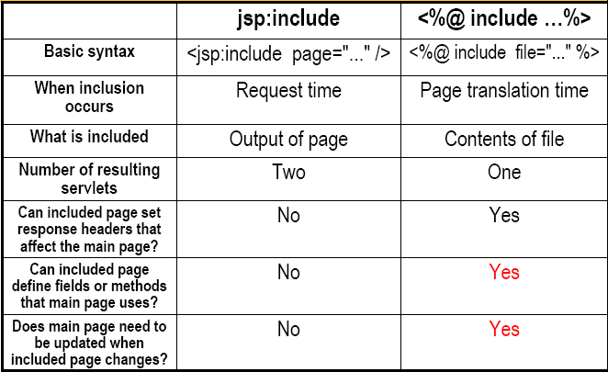
jsp:include vs. <%@ include …>

Slide 53
Which Should You Use?
Use jsp:include whenever possible
  Changes to included page do not require any manual updates
  Speed difference between jsp:include and the include directive (@include) is insignificant
The include directive (<%@ include …%>) has additional power, however
  Main page
    <%! int accessCount = 0; %>
  Included page
    <%@ include file="snippet.jsp" %>
    <%= accessCount++%>

Slide 54
Lets us Move Ahead…..

